Slide 1
COVID-19 Survey for Municipalities
Survey Source: Survey Monkey

Slide 2
82 Total Responses
Survey Open April 14-22, 2020

Slide 3
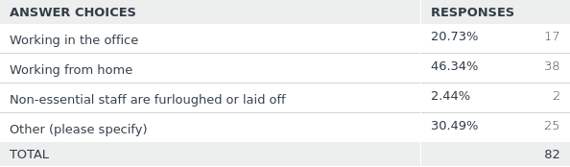
Q1:
Aside from police, fire, and emergency management staff, what is the status of the majority of municipal staff? (choose one)
21%
46%
2%
30%
Other = staff rotating/splitting time between office and home - 25

Slide 4
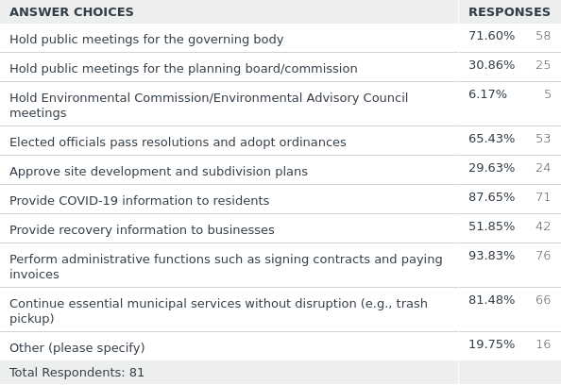
Q2:
Which municipal operations are you able to continue during this time? (check all that apply)
72%
31%
6%
65%
30%
88%
52%
94%
81%
20%
Other = Review/process permits; perform essential municipal functions only; hold public meetings

Slide 5
Q3:
Which Muni services are not being provided due to COVID-19?
Permitting, inspections, code enforcement – 12
Libraries, parks, rec facilities, community events: closed and cancelled – 3
Limited Public Works: no street sweeping, grass cutting, road maintenance, sewer pump maintenance, bulk trash pick up – 5
Municipal Court closed – 1

Slide 6
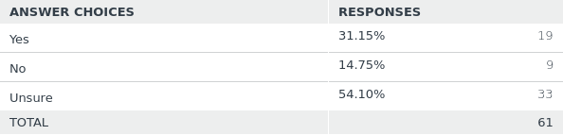
Q4:
Are you planning to apply for emergency funds through the federal CARES Act?
31%
15%
54%
Q5:
If yes, which relief program?
FEMA/PEMA – 3
Lost revenue/economic relief – 6

Slide 7
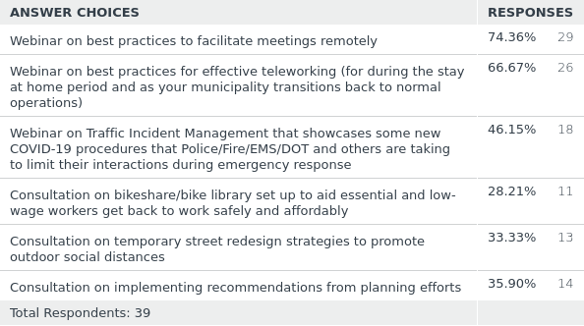
Q6:
Are you interested in any of the following technical assistance resources provided by DVRPC and partners? (check all that apply)
74%
67%
46%
28%
33%
36%

Slide 8
Q7:
Promising Practices Implemented or Observed
Homeless Shelters for those with COVID-19
Pop up testing sites
Designated street parking spaces for restaurant curb-side pickup
Providing wifi access in parking lots
Online park and recreation activity for residents
Online list of locally operating businesses and their hours
Amnesty period for permits, paying EIT, and real estate taxes
Church, school district and police food distribution to those in need
Websites showing assistance programs for employee benefits, food bank locations, and mortgage, rent and utility bill relief
Using Nixle to provide COVID-19 updates

Slide 9
Q8:
As a municipal official, what are you most worried about?
Declining tax revenue impacts on municipal operations and staffing – 23
Local small business/Main Street closures – 15
Residents’ and employees’ health and safety/how to go back to work safely – 14
Economic recession – 9
Second wave of infections – 6
What will be the new normal – 4
How will already distressed towns recover – 2
Even less public participation and volunteerism – 1
Backlash from residents displeased with gov’t response – 1
Mass transit – 1
Psychological aftermath of fear and mistrust – 1

Slide 10
Q9:
Is there anything else DVRPC might assist with or you’d like to share?
Provide data on impact to region: lost revenue, unemployment, VMT, etc.
Keep sending info
Share best practices and funding for multi-modal planning and infrastructure improvements
Provide options for moderated teleconferencing for public meetings
Communicate about grant opportunities and local business development opportunities
Extend grant deadlines
Help organize emergency management at state, county and local levels
Need more free food distribution
Use opportunity to get people used to a low impact lifestyle
Provide programs for small municipalities for funding payroll and debt

Slide 11
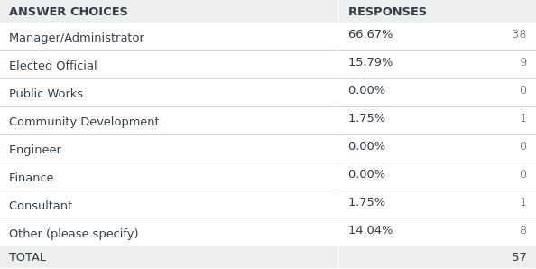
Q10:
What is your role with the municipality?
67%
16%
0%
2% 0%
0%
2%
14%
Other: Assistant Manager, Planner, Clerk, Emergency Manager, Zoning Officer, Secretary

Slide 12
COVID-19 Upcoming Webinars and Programs
We’ll make weekly announcements and post registration links on the COVID-19 webpage:
Adapting Streets for Safe Outdoor Social Distancing – May 15, 2:00 – 3:00
Best Practices for Remote Meetings – May 19, 2:00 – 3:30
Bike Sharing/libraries and matching – May 22, 1:00 – 2:00
Best Practices for Teleworking - May 26, 11:00 – 12:30
New Incident Management Practices during COVID-19 - TBA
The 5Ps that aren’t Pandemic: strategies for small businesses - TBA
Regional Bike Match Program: matching those in need of a bike with those who have one to spare- TBA

Slide 13
Thank You!
Questions?
Contact: Patty Elkis
pelkis@dvrpc.org

